Slide 1








Stack Overflow Developer Survey for Year 2019
Elizabeth Ofori
August 9, 2024

Slide 2



OUTLINE
Executive Summary
Introduction
Methodology
Results
Visualization – Charts
Dashboard
Discussion
Findings & Implications
Conclusion
Appendix

Slide 3

EXECUTIVE SUMMARY
Competitive Nature of IT Industry: The IT industry is dynamic and competitive, necessitating continuous updates to programming skills and database knowledge.
Project Objective: This project aims to analyze and identify key trends within the IT industry.
Key Areas of Analysis:
Current Technology Usage: Assessing the current state of programming languages, databases, and platforms used.
Future Technology Trends: Predicting upcoming trends in programming languages, databases, and platforms.
Demographics in IT Industry: Understanding the distribution of gender, age, and education levels in IT.
Goals:
Identifying top Programming Languages in the industry.
Top Database Skills in high demand.
Popular IDEs among professionals.

Slide 4

INTRODUCTION
Stack Overflow’s annual Developer Survey is the largest and most comprehensive survey of people who code around the world. Each year, they field a survey covering everything from developers’ favorite technologies to their job preferences. 2019, marks the ninth year they published their annual Developer Survey results, and nearly 90,000 developers took the 20-minute survey.
Despite their survey’s broad reach and capacity for informing valuable conclusions, I acknowledged that their results don’t represent everyone in the developer community evenly. They have done further work to make Stack Overflow a welcoming, inclusive, and diverse platform.
Based on their data collection, we cleaned and prepare the data to suit our research demands. We present few findings in this presentation.

Slide 5

METHODOLOGY
Collect survey data & explore its content
Web Scraping
APIs.
Request library.
Data Wrangling
Exploratory data analysis
Analyzing data distribution.
Handling outliers.
Correlations.
Data Visualization
Highlight of the distribution of data, relationships, the composition and
comparison of data.
Dashboards

Slide 6
RESULTS
Python is the fastest-growing major programming language since it has risen in the ranks of programming languages in the survey.
Over half of respondents had written their first line of code by the time they were sixteen, although this experience varies by country and by gender.
Of the top countries on the survey, China has developers that are the most optimistic, believing that people born today will have a better life than their parents. Developers in Western European countries like France and Germany are among the least optimistic about the future.
Respondents were asked to think about the last time they solved coding problems with and without Stack Overflow website. The data indicates that Stack Overflow saves a developer 30 to 90 minutes of time per week!

Slide 7
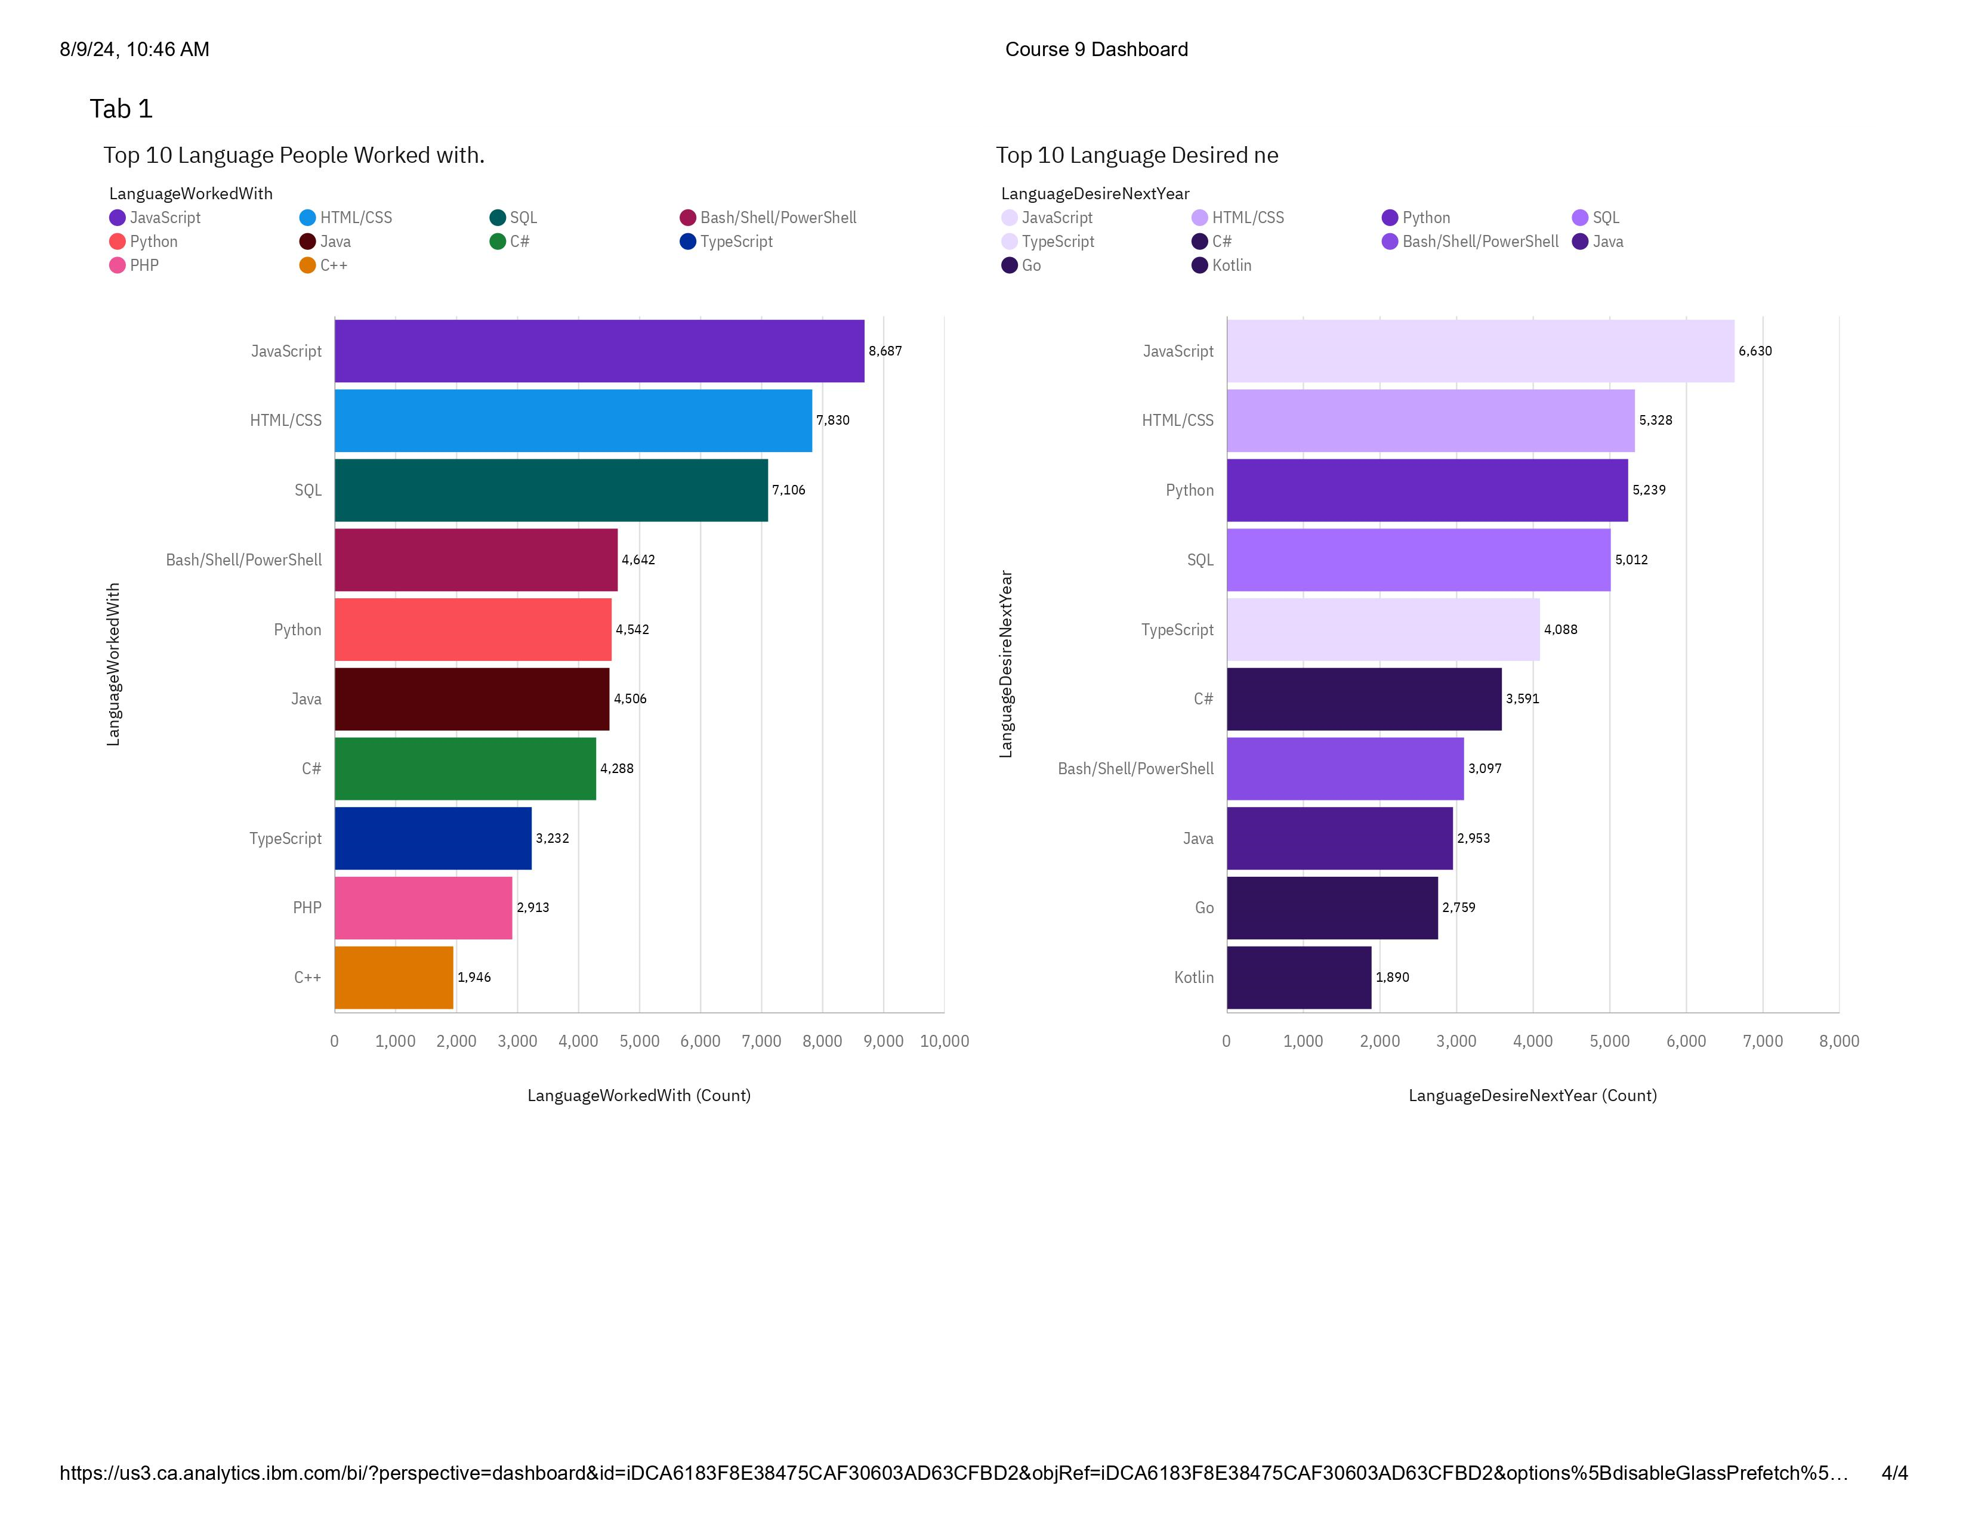
PROGRAMMING LANGUAGE TRENDS
Current Year
Next Year

Slide 8
PROGRAMMING LANGUAGE TRENDS - FINDINGS & IMPLICATIONS
Findings
For seven years in a row, JavaScript has been the most commonly used programming language, but Python has risen in the ranks again.
In the year 2019, Python edged out Java in the overall ranking. In the same way; Python surpassed C+ in 2018 l and PHP in 2017.
We conclude that Python is the fastest-growing major programming language today.
Implications
JavaScript must be an easy program that is easy to understand so people still enjoy working with it.
Python is an interesting program as it keeps on attracting new people each year.

Slide 9
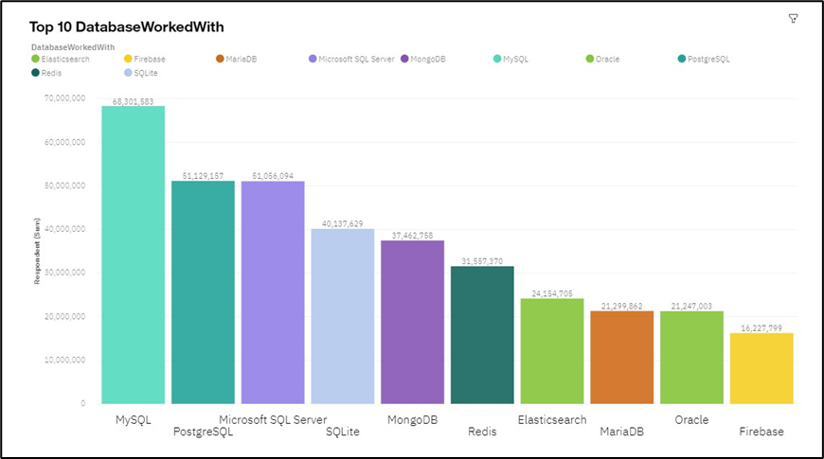
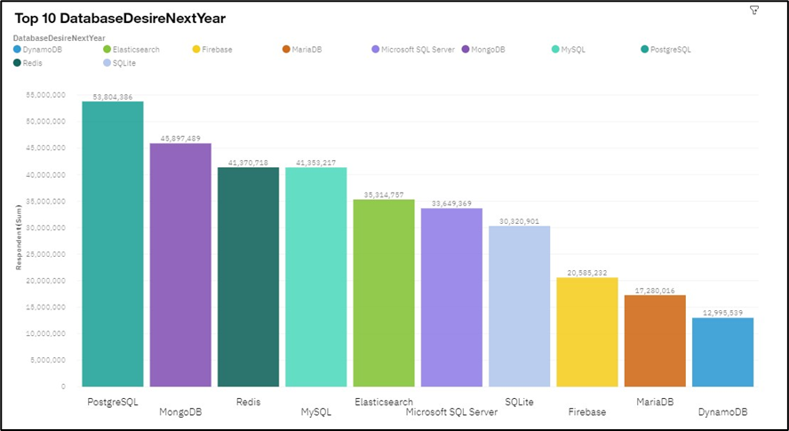
DATABASE TRENDS
Current Year
Next Year
Bar chart of top 10 databases for the current year goes here
Bar chart of top 10 databases for the next year goes here.

Slide 10
DATABASE TRENDS - FINDINGS & IMPLICATIONS
Findings
MySQL is the most used database currently.
There is a lack of interest in Microsoft SQL Server and SQLite.
Increasing interest in PostgreSQL and MongoDB.
Implications
Microsoft SQL Server and SQLite losing ground in the market.
PostgreSQL and MongoDB establishment in the market.
SQL Server and SQLite are losing ground in the market because their storage capacity might be low compared to PostgreSQL and MongoDB

Slide 11

DASHBOARD
<The GitHub link of the Cognos/Looker Studio dashboard goes here.>

Slide 12
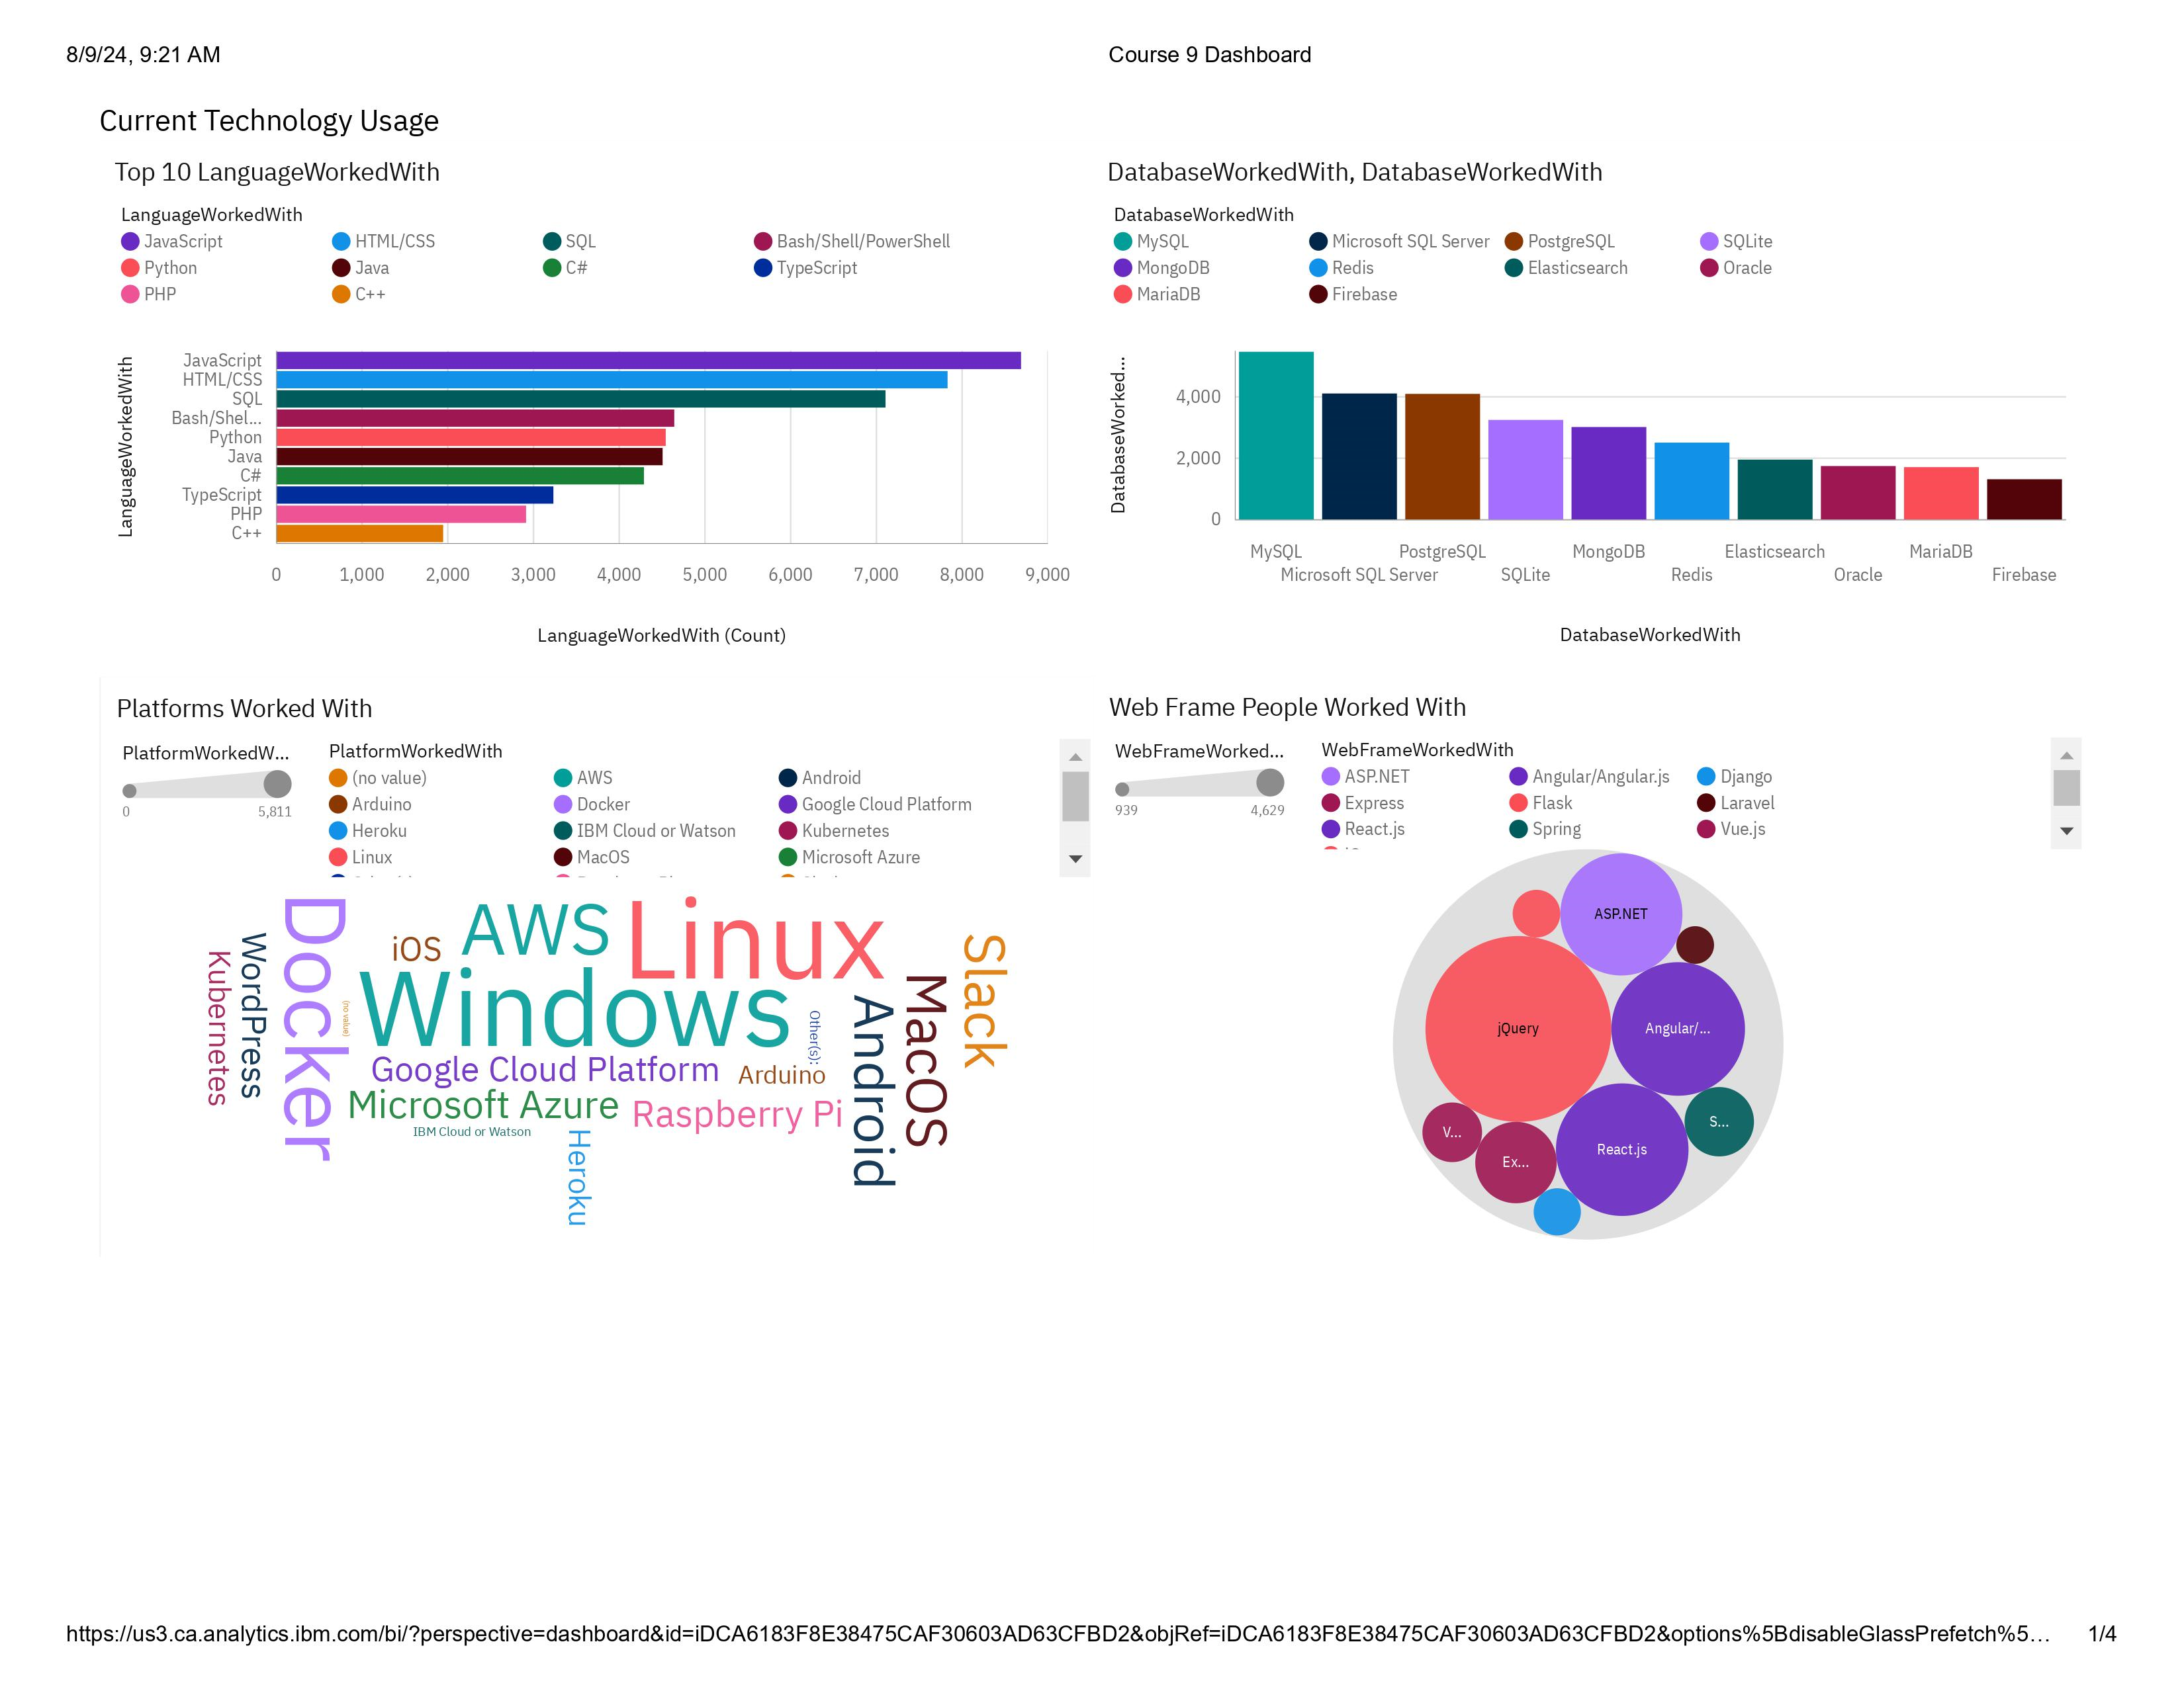
DASHBOARD TAB 1

Slide 13
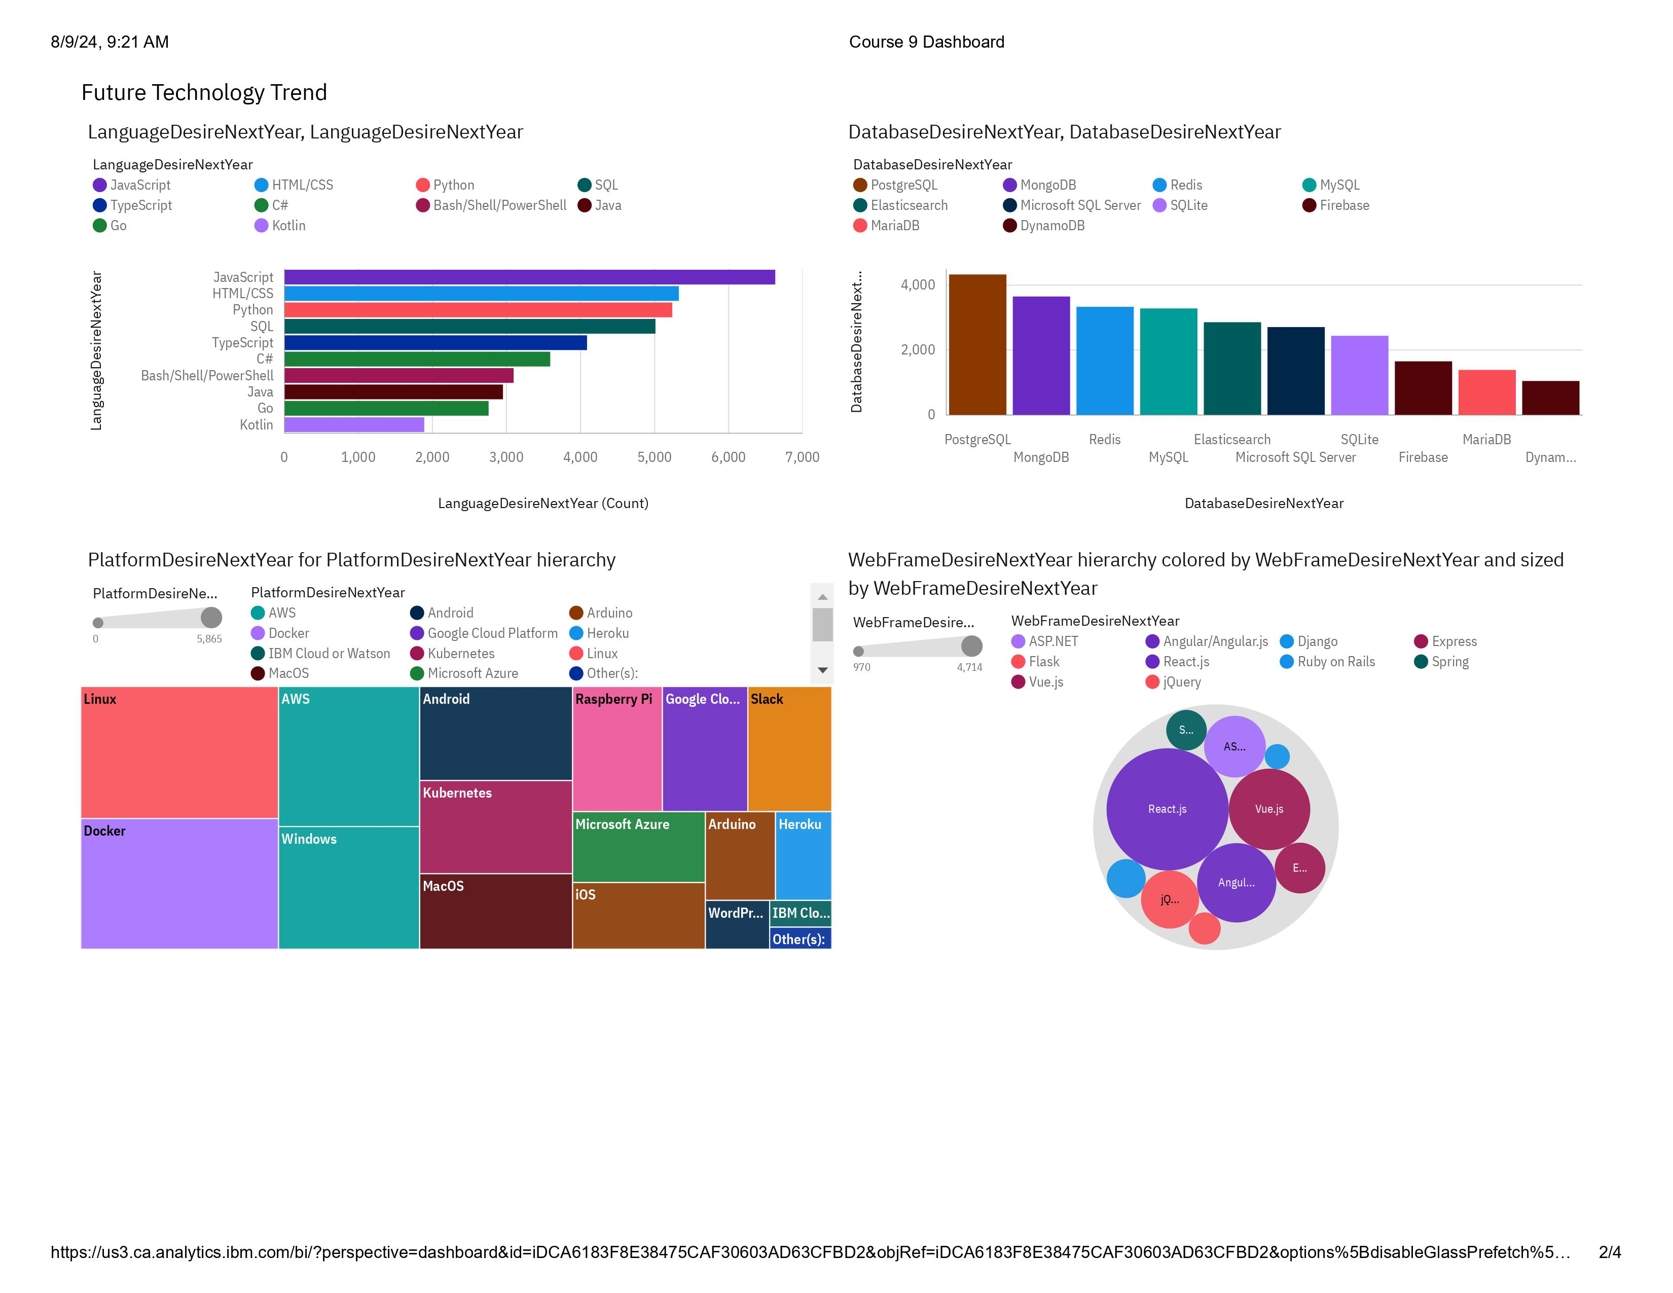
DASHBOARD TAB 2

Slide 14
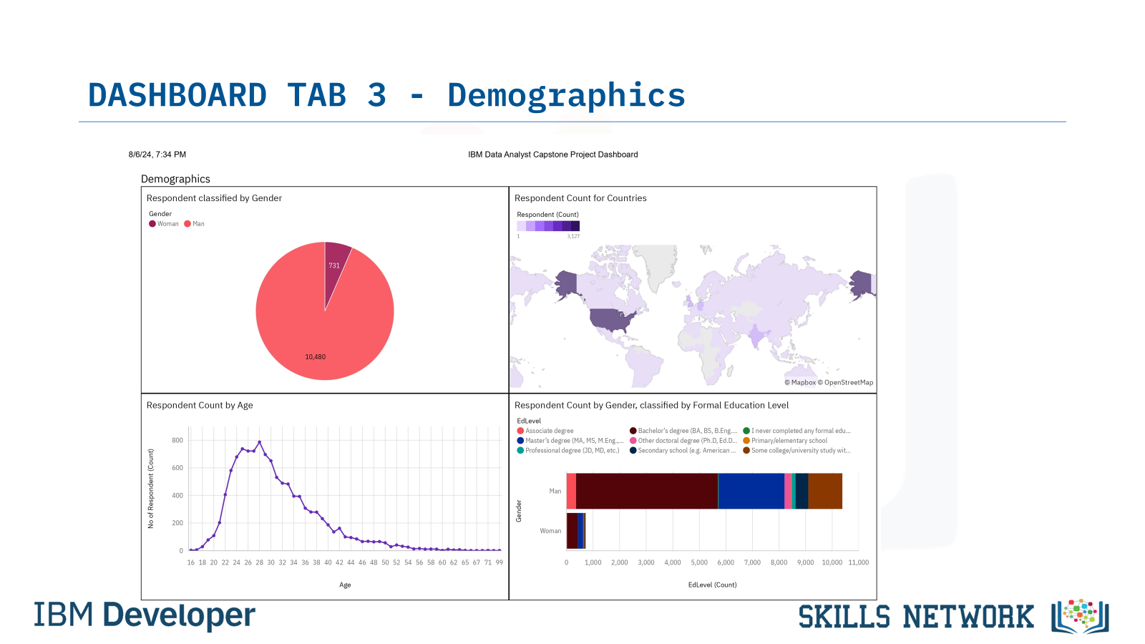
DASHBOARD TAB 3

Slide 15
DISCUSSION
Must-Have Skills and Desirable Future Trends:
Languages are gaining significant popularity
JavaScript
Python
HTML/CSS
SQL
TypeScrip
Databases which are becoming more popular options
PostgreSQL
MongoDB
Redis
MySQL
Elasticsearch
Popular IDEs:
React.js
Angular/Angular.js
Vue.js
jQuery
ASP.NET

Slide 16
OVERALL FINDINGS & IMPLICATIONS
Findings
JavaScript is widely used, and TypeScript is getting popularity.
Over 90% of men are developers whiles about 6% developers are women.
Developers are mostly located in well developed countries.
Implications
JavaScript and TypeScript web frames gaining followers.
Global polarization of developers location and gender.
Young developers without postgrad studies on its majority.

Slide 17

CONCLUSION
Unbiased Data Analysis:
Open source data from Stack Overflow helps avoid data bias.
Shift in Technology Trends:
Changes in current technology usage highlight the need for updated skills.
Updated Skill Requirements:
Programming Languages:
JavaScript, Python, HTML/CSS, SQL, TypeScript
Databases:
PostgreSQL, MongoDB, Redis, MySQL, Elasticsearch
IDEs:
React.js, Angular/Angular.js, Vue.js, jQuery, ASP.NET
Key Takeaway:
To remain competitive, IT professionals must adapt to evolving trends in programming languages, databases, and IDEs.

Slide 18
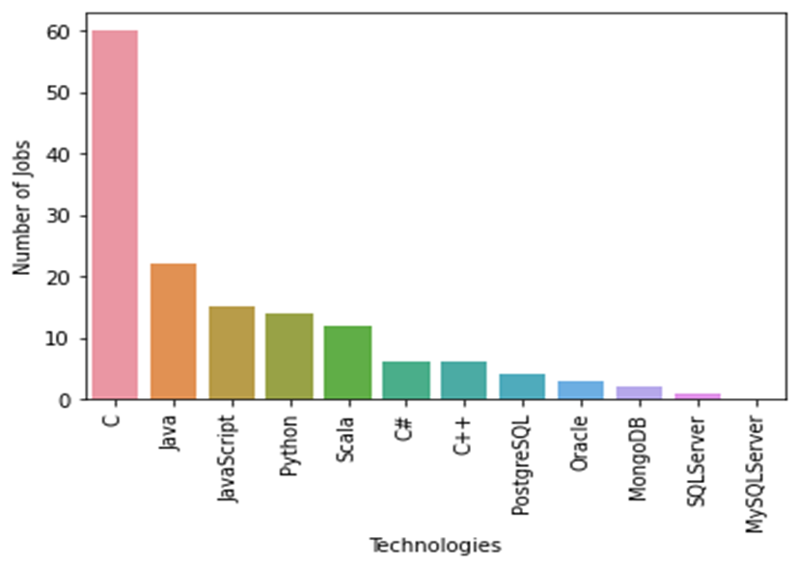
JOB POSTINGS
In Module 1 you have collected the job posting data using Job API in a file named “job-postings.xlsx”. Present that data using a bar chart here. Order the bar chart in the descending order of the number of job postings.

Slide 19
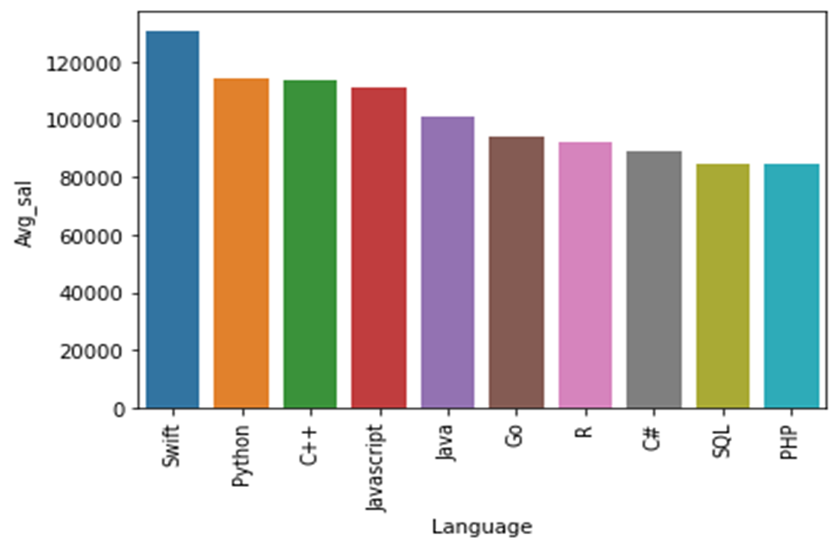
POPULAR LANGUAGES
In Module 1 you have collected the job postings data using web scraping in a file named “popular-languages.csv”. Present that data using a bar chart here. Order the bar chart in the descending order of salary.

